Slide 1

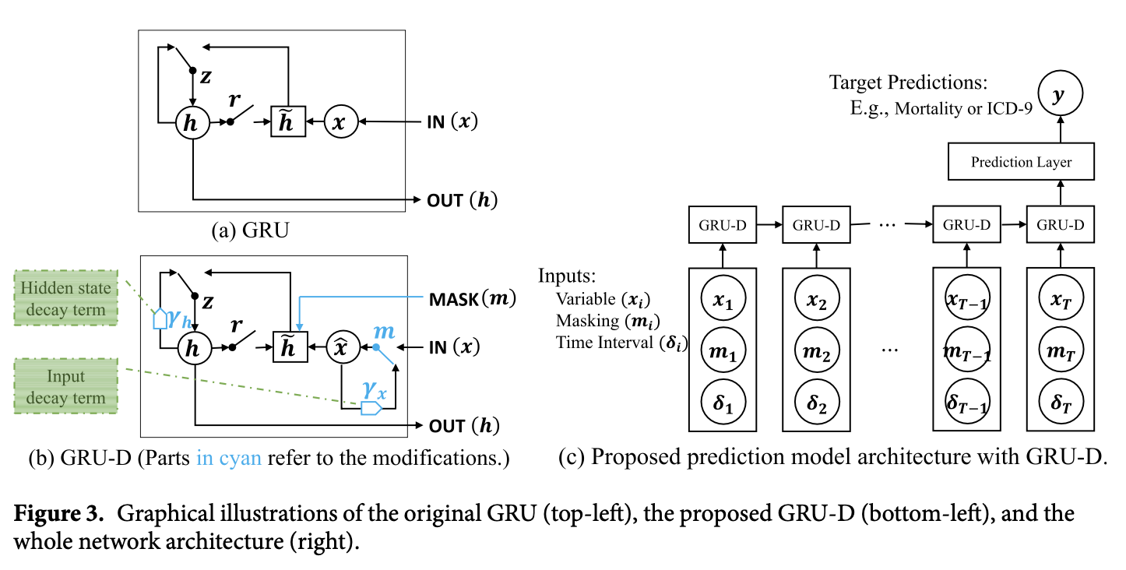
GRU-D (2018)

Slide 2

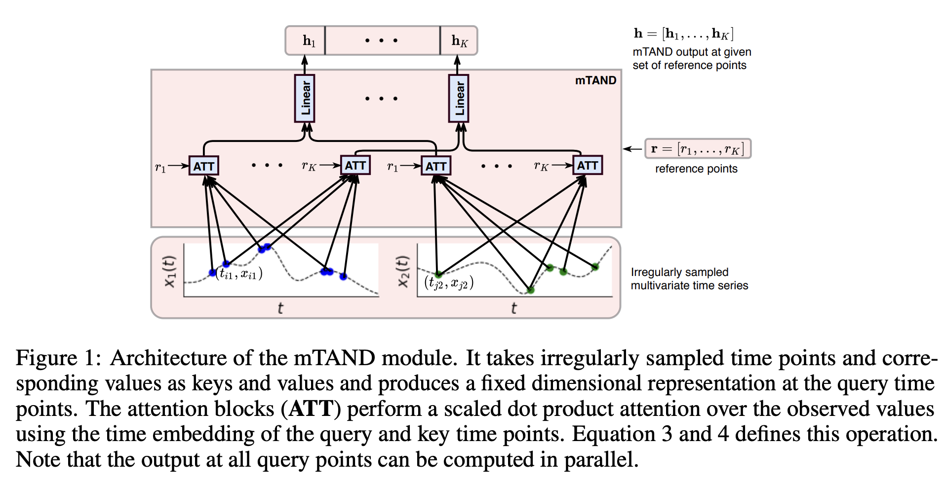
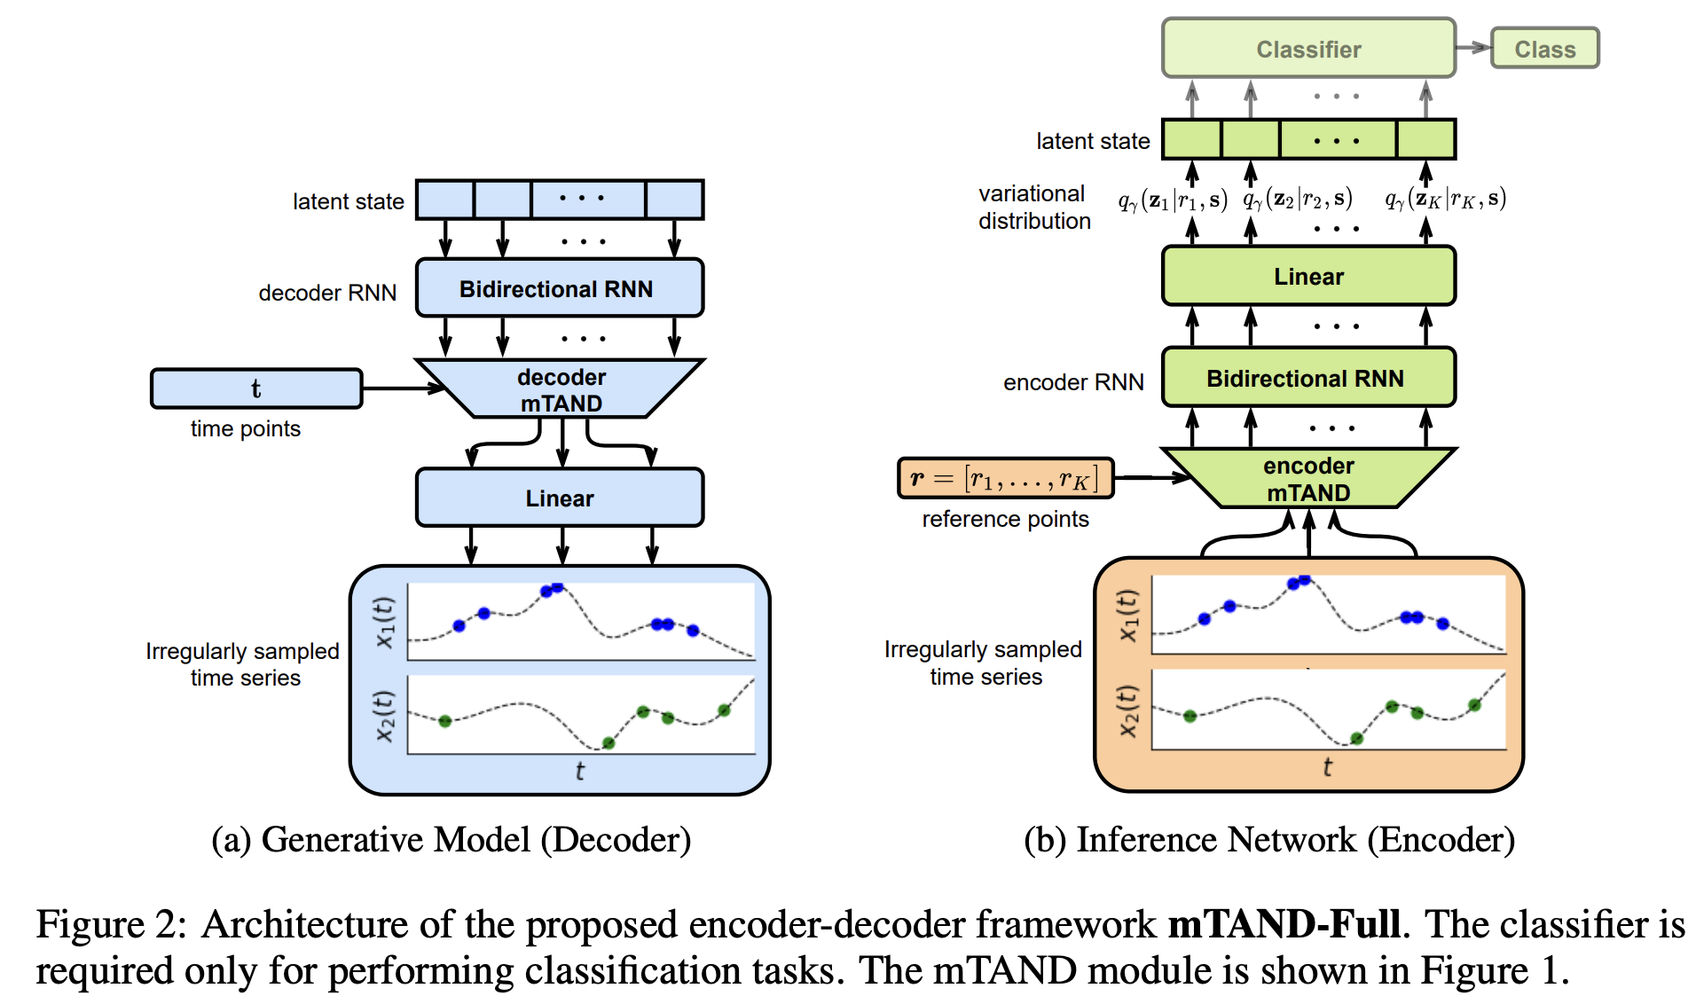
mTAND (2021)
Notes:
Given any multivariate time series, mTAND module is essentially a continuous-time embedding module that gives outputs an embedding of multiple irregularly sampled variables at any query time, thanks to the attention mechanism

Slide 3
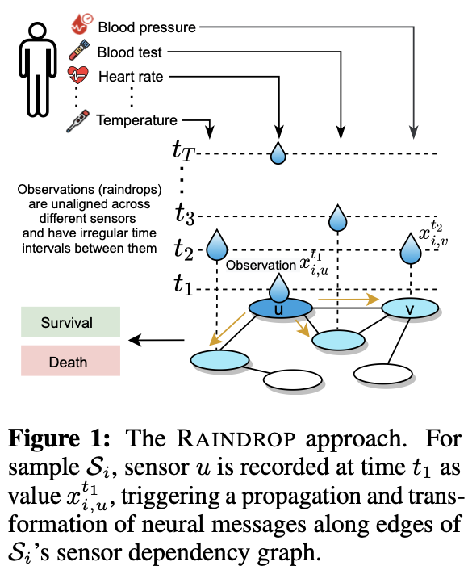
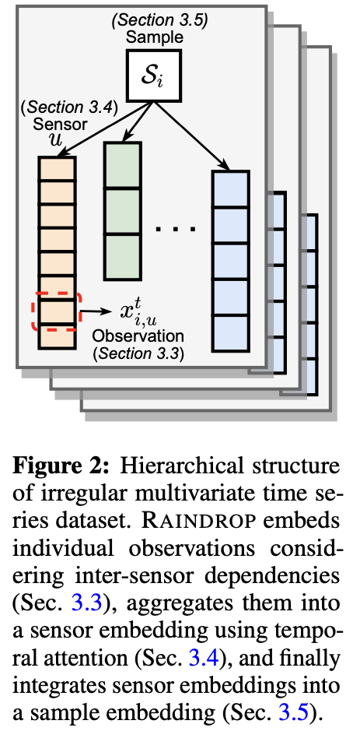
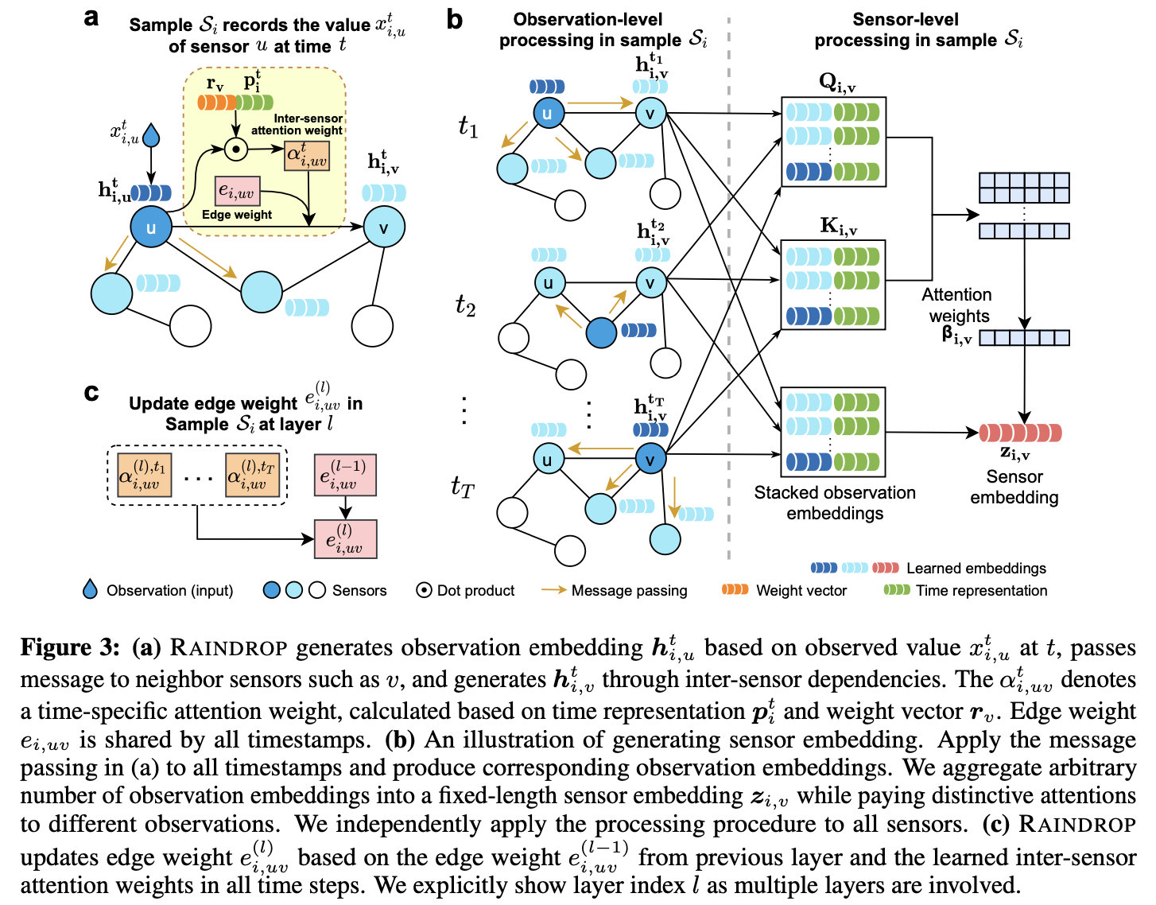
Raindrop (2022)

Slide 4
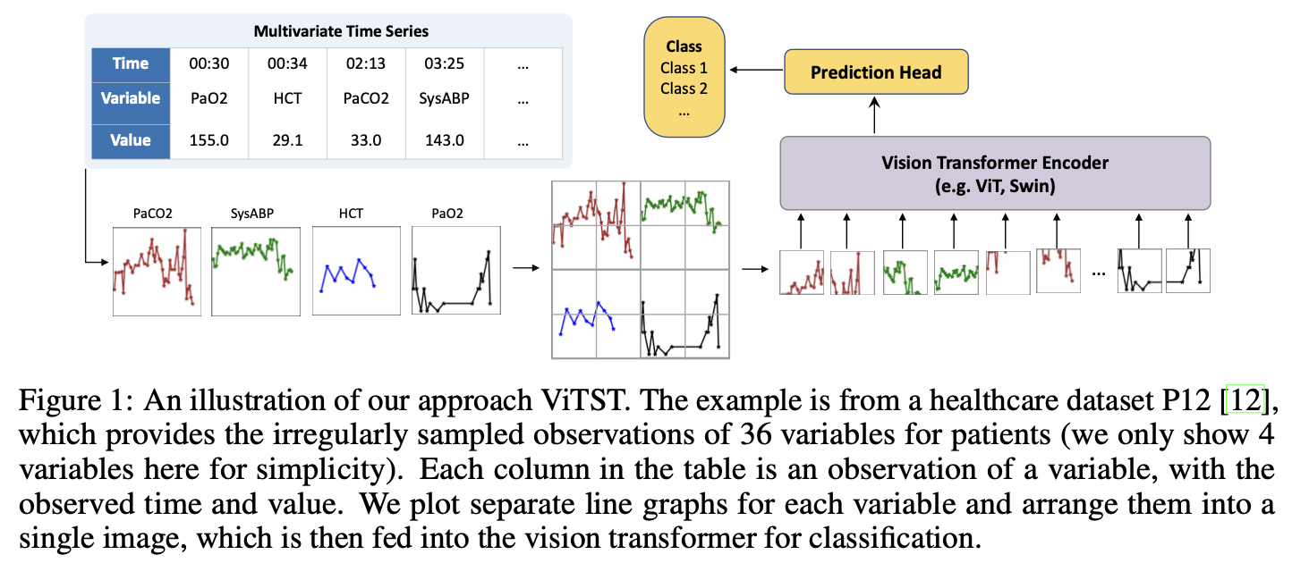
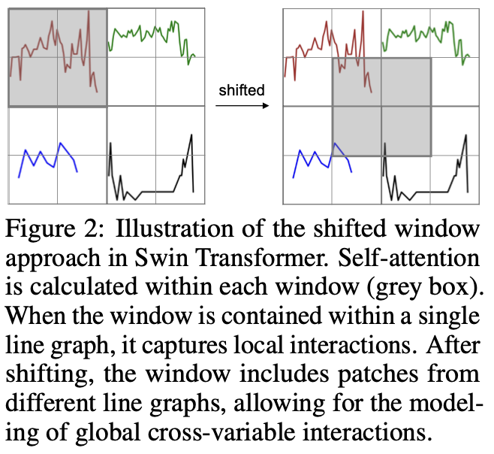
ViTST (2023)

